Slide 1
Santa’s Castle
Mission is to ease holiday stress by providing new toys, board games and books to Active Military Families in Washington who are experiencing financial hardships.

Slide 2
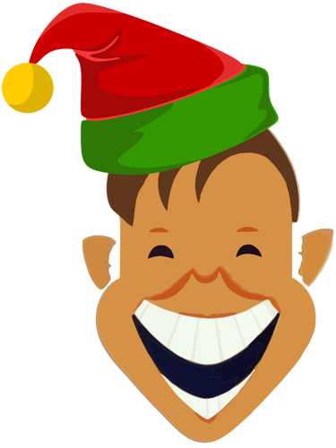
Volunteer Elves
Training: Nov 1 -10
Service Dates: Nov 27 - Dec 1, Dec 4 - 8
2 hour shifts

